Slide 1


Slide 2
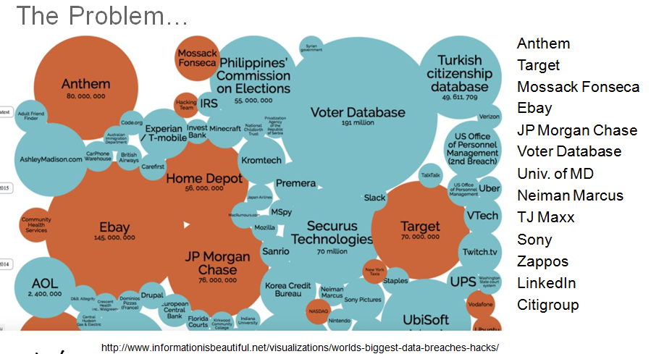

Slide 3


Slide 4
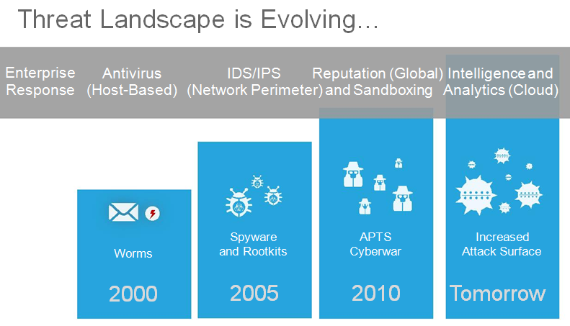

Slide 5
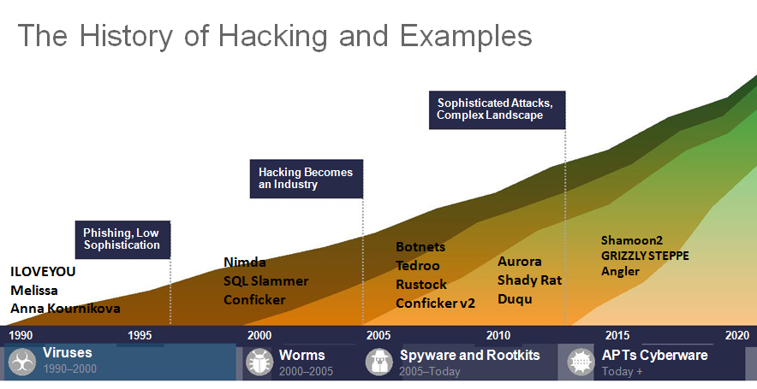

Slide 6
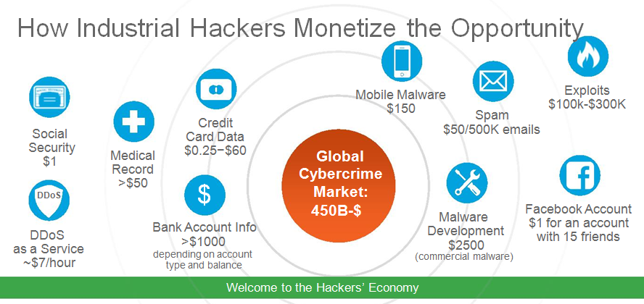

Slide 7
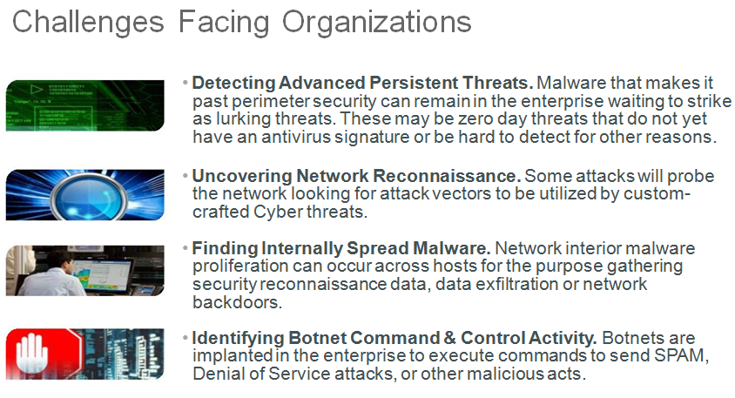

Slide 8
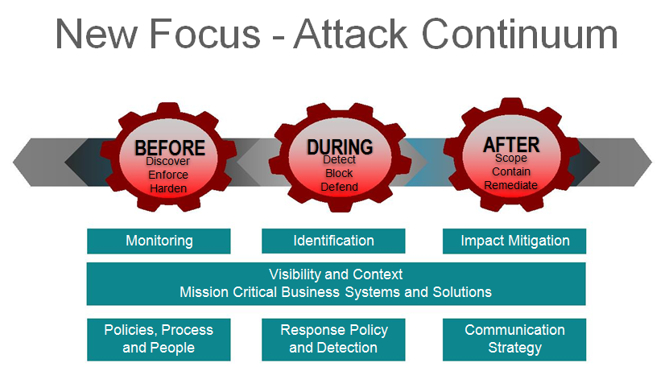

Slide 9
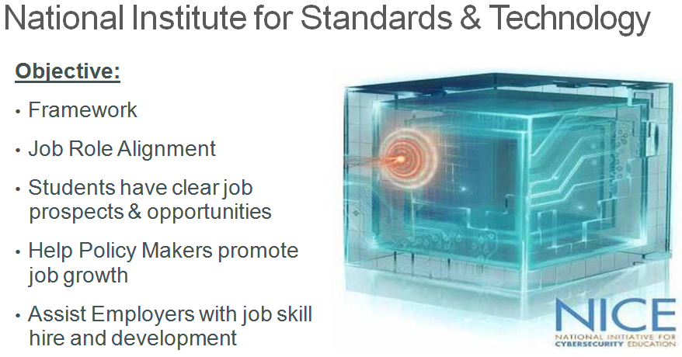

Slide 10
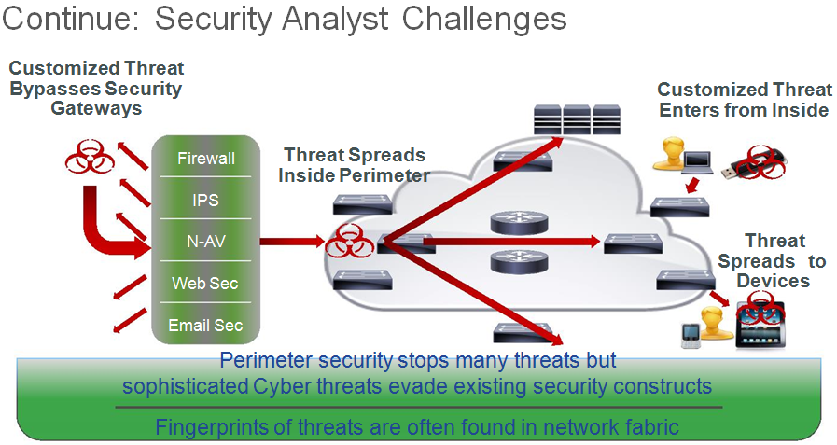

Slide 11
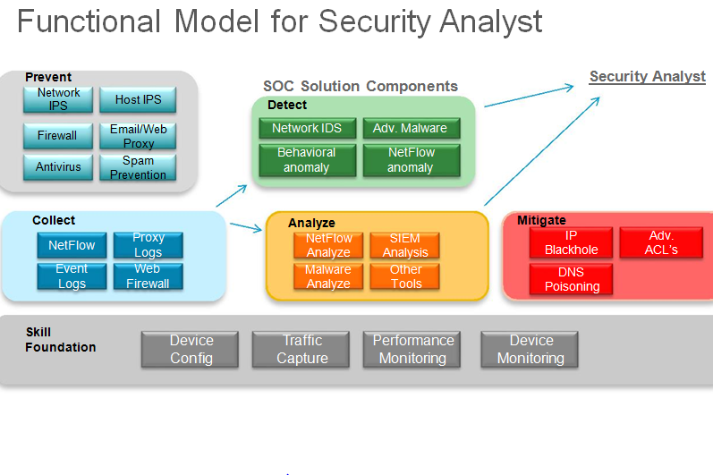

Slide 12
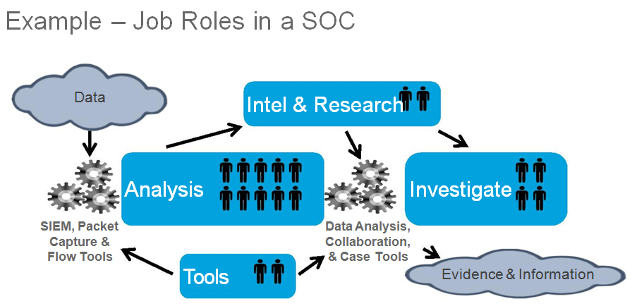

Slide 13
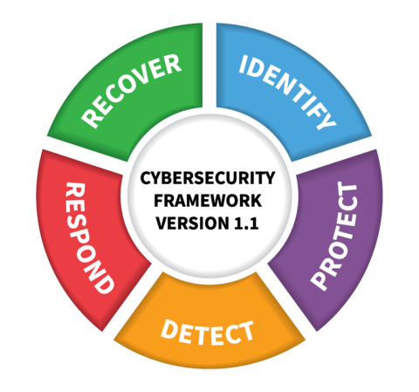
CyberOps Associate prepares students for Jobs
Typical Associate
Positions
SOC Analyst
Incident Responder
Digital Forensics
Auditor
CyberOps Associate
Detecting Intrusions
Monitoring, analyzing
First response
Alignment with National Institute of Standards and Technology (NIST) Cybersecurity Framework
Notes:
Alignment of Courses to NIST Framework
Alignment of the NetAcad courses to support skills building in the cybersecurity functions defined by the NIST Cybersecurity Framework...
New or old positions – primarily same positions

Slide 14
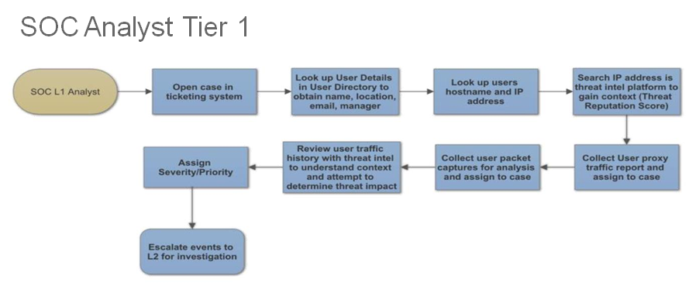

Slide 15
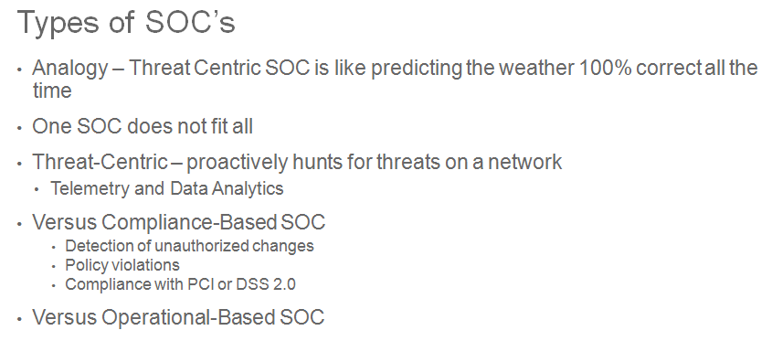

Slide 16
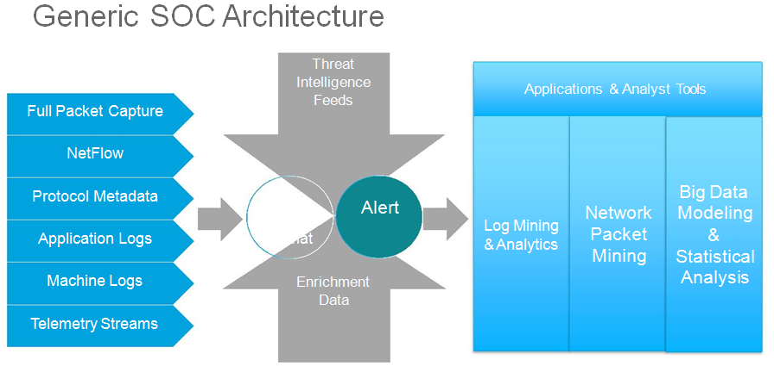

Slide 17
CyberOps Associate Certification exam topics
What’s new ?
The focus is on Sec-Ops
It is simplified – moving from 2 exams to 1 exam
Security Policies and Procedures is a new exam topic
It is more vendor neutral
It enables students to think about the right datapoints in an evolving landscape
Notes:
Focus on things to consider
Vs tools
Diffrentiaors-
To describe/ consider during the
Describe/explain

Slide 18
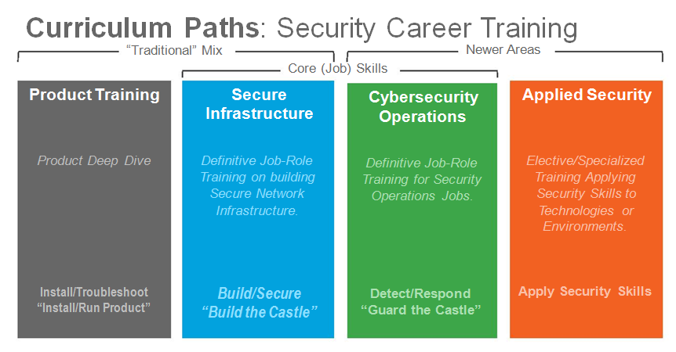

Slide 19
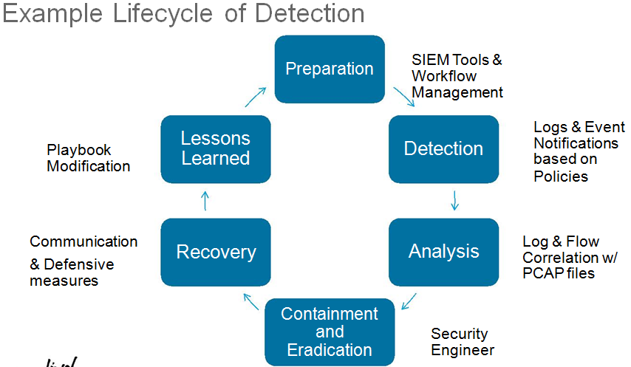

Slide 20
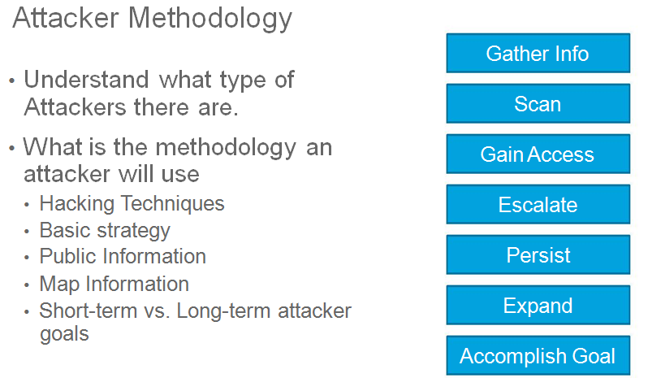

Slide 21
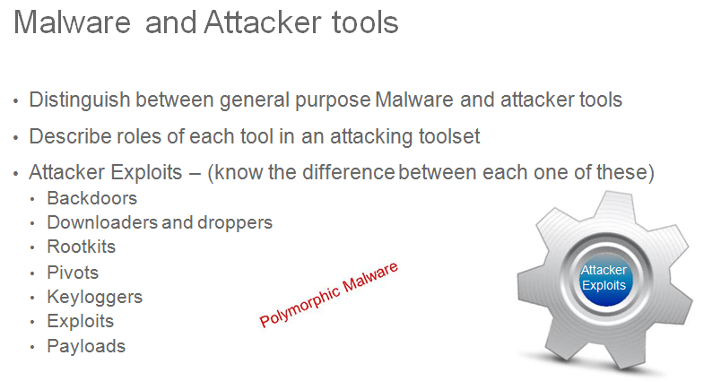

Slide 22
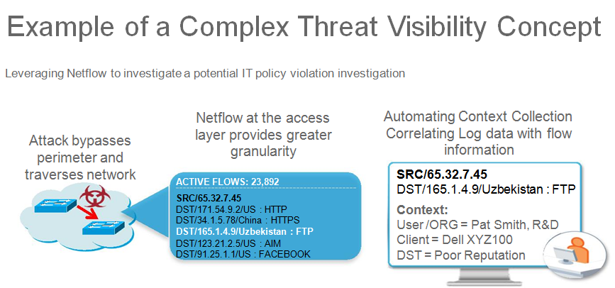

Slide 23
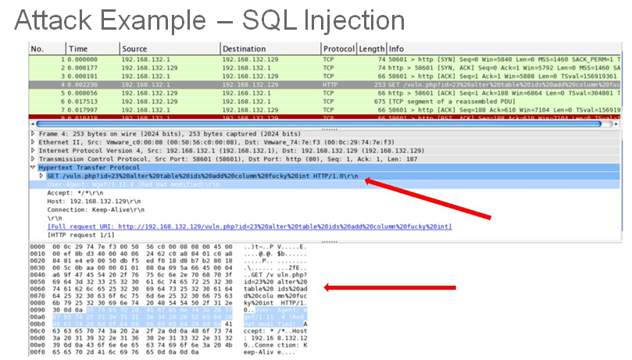

Slide 24
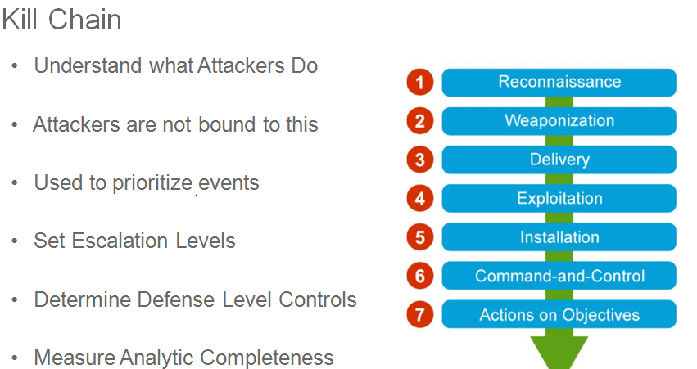

Slide 25
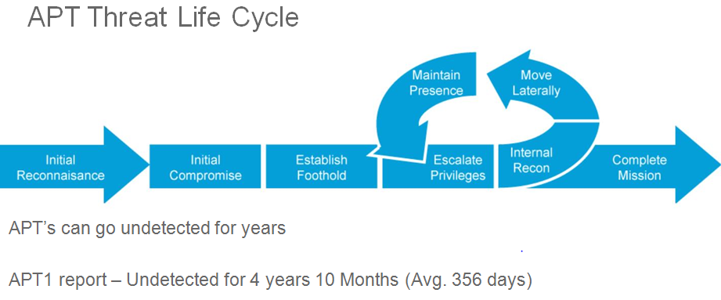

Slide 26
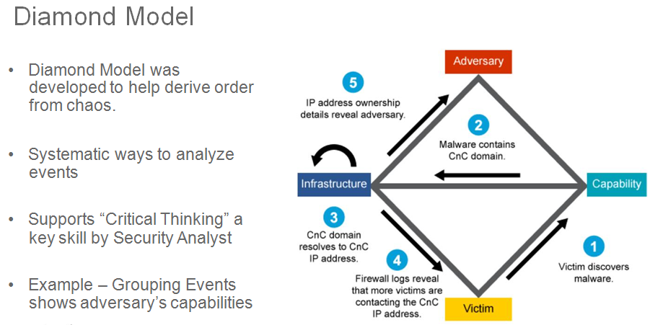

Slide 27
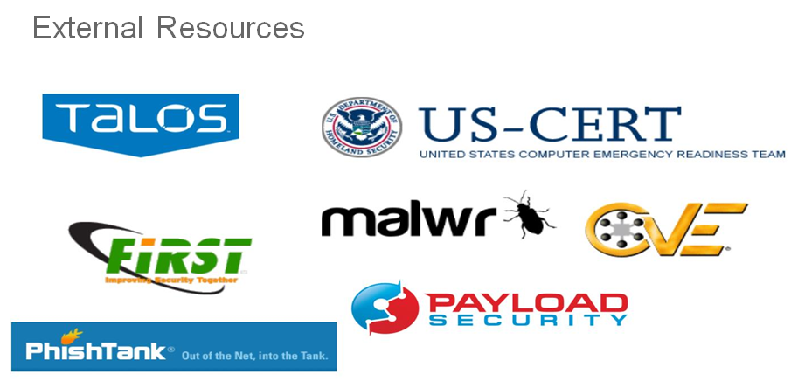

Slide 28
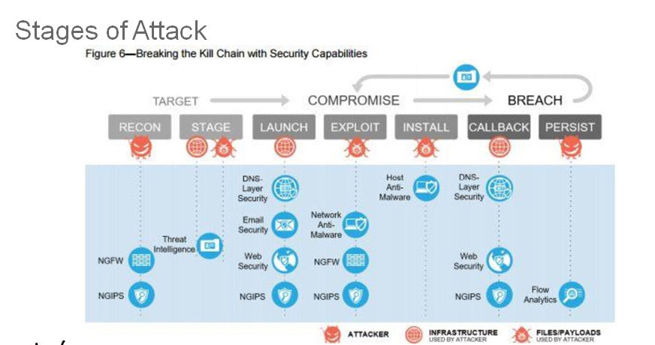

Slide 29
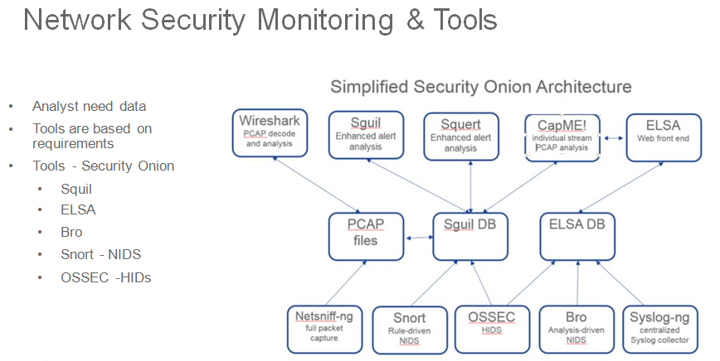

Slide 30
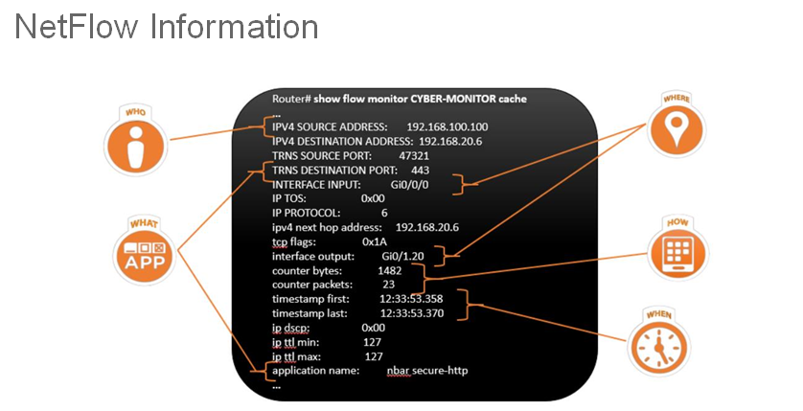

Slide 31
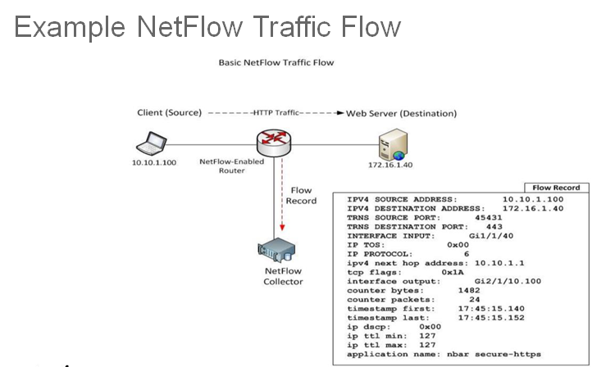

Slide 32
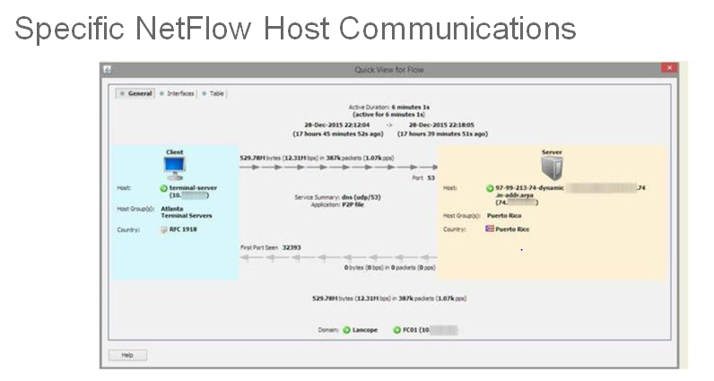

Slide 33
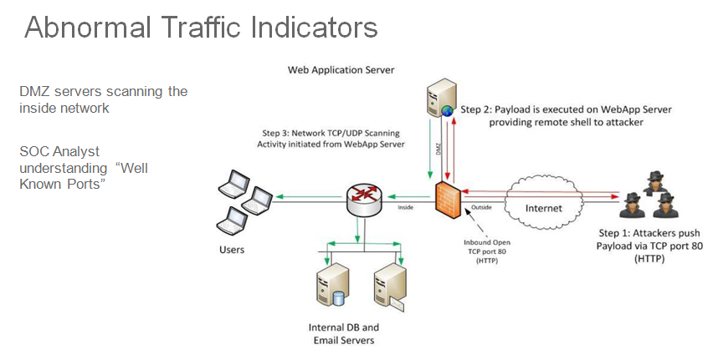

Slide 34
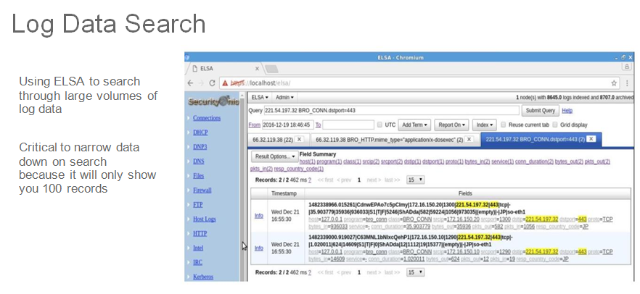

Slide 35
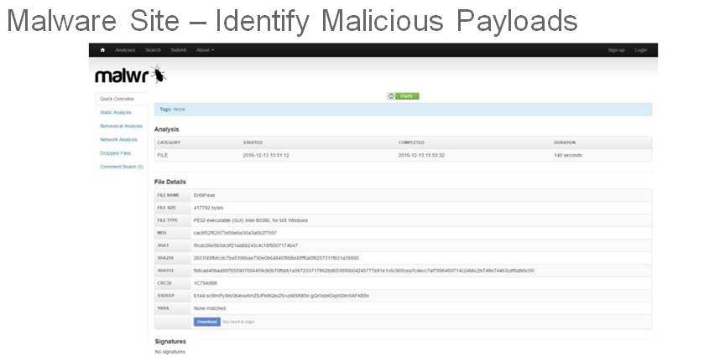

Slide 36
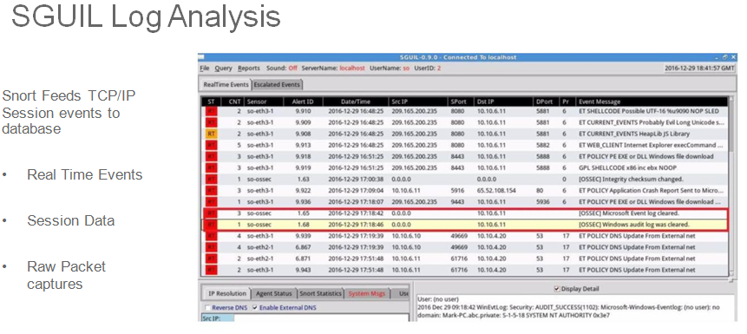

Slide 37
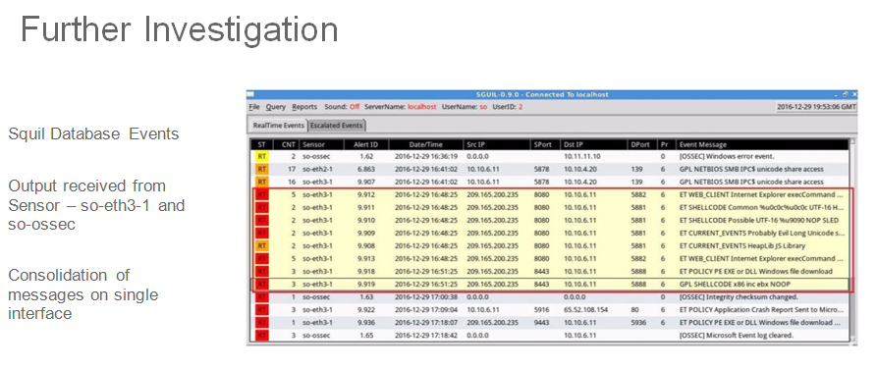

Slide 38


Slide 39
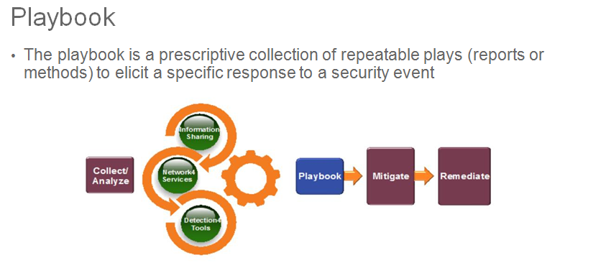

Slide 40
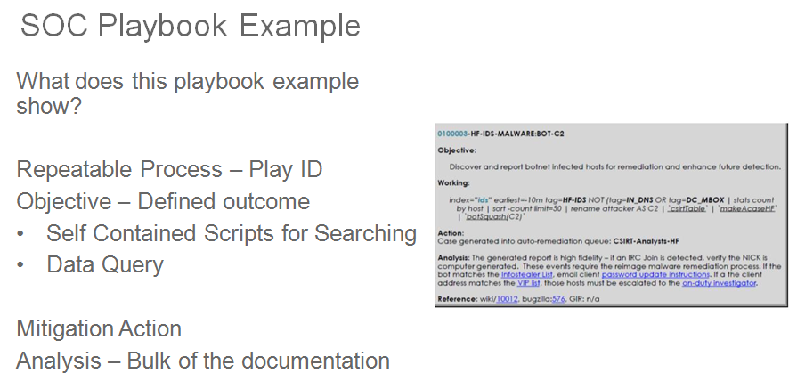

Slide 41


Slide 42
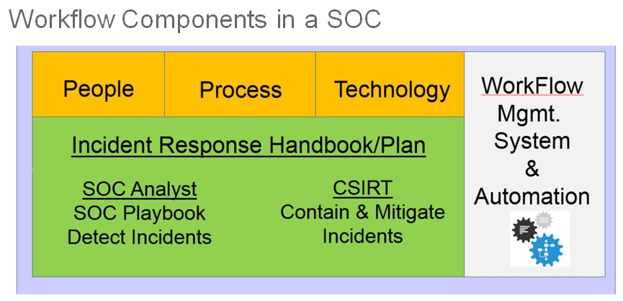

Slide 43
